Slide 1

Enhancing Operational Efficiency in a Multispecialty Hospital
Name: Dennis
Date: XX/XX/XXXX

Slide 2
Table of Contents
Executive Summary
Introduction
Business Objectives
Methodology
Requirements Gathering (BRD and RTM)
Stakeholder Analysis and Engagement Plan
Scope Management Plan
Data Analysis
Data Visualization
Process Mapping
Risk Assessment Plan
Risk Mitigation Plan
Findings and Recommendations
Key Findings
Key Recommendations
Conclusion
Appendix

Slide 3
Executive Summary
Outline the problem, key insights, and recommended actions in 6 bullet points.
Problem:
Long patient wait times
Resource allocation challenges
Communication gaps across departments
Key insights:
Delays exceeding 30 minutes
Limited communication regarding the status of their appointments
Recommended actions:
Automating appointment scheduling
Reducing double bookings
Streamlining resource allocation

Slide 4
Introduction
Summarize the opportunity, describe the approach, and outline the key questions or hypotheses to be analyzed in 6 bullet points.
Opportunity:
1. Improve patient experience by overhauling the scheduling and communication systems to reduce wait times, cancellations, and confusion.
2. Optimize operational efficiency by addressing resource allocation, outdated systems, and inter-departmental communication gaps among doctors, nurses, and administrative staff.
Approach:
1. Conduct system-wide diagnostics to identify key inefficiencies in scheduling, resource usage, and data management using interviews, process mapping, and system audits.
2. Implement an integrated Hospital Information System (HIS) with real-time scheduling, notification, and analytics capabilities across departments.
Key questions/hypotheses:
Would integrating scheduling, billing, and record systems reduce double-bookings and patient complaints?
Can a real-time notification system significantly reduce missed appointments and patient frustration?

Slide 5
Business Objectives
Areas of improvement in 6 bullet points:
Enhance Patient Scheduling Experience
Improve Communication and Notifications
Optimize Resource Allocation
Streamline Inter-departmental Communication
Upgrade Legacy IT Infrastructure
Enable Data-Driven Decision-Making

Slide 6

Methodology

Slide 7
Requirements Gathering: Business Requirement Document (BRD)
Problem statement:
HealthFirst Care is currently challenged by outdated manual scheduling processes that result in long patient wait times and frequent double bookings. Patients experience delays exceeding 30 minutes and receive limited communication regarding the status of their appointments. Concurrently, resource allocation throughout the hospital is hampered by scheduling conflicts and a lack of real-time visibility into department availability. These issues create operational bottlenecks, reduce staff efficiency, and negatively impact patient satisfaction
Key requirements to improve operational efficiency:
Unified Scheduling System An integrated, user-friendly platform accessible to patients and staff for real-time appointment booking, cancellation, and rescheduling.
Automated Notifications System-generated SMS/email alerts for appointment confirmations, delays, cancellations, and post-consultation follow-ups.
Real-Time Resource Availability Dashboard View of doctors’ availability, room occupancy, and equipment status to prevent bottlenecks and overbooking.

Slide 8
Requirements Gathering: Business Requirement Document (BRD)
Constraints:
Budget Limitations: Deployment must stay within the defined capex/opex constraints.
Integration Feasibility: New systems must be compatible with existing hospital infrastructure and third-party platforms.
Data Privacy Compliance: Must adhere to HIPAA/GDPR or local data protection laws.
Training Requirements: All users must be trained within a limited onboarding timeframe.
Downtime Minimization: System upgrades must not disrupt ongoing hospital operations.
Acceptance criteria:
Scheduling System: ≥ 95% of patients must be able to book appointments online without support.
Notification System: Appointment alerts must be sent within 1 minute of scheduling changes
Resource Dashboard: Real-time updates must reflect changes in doctor or equipment availability within 30 seconds.
Cross-Department Communication: Inter-departmental update time must improve by 70% within 2 months post-implementation.
Analytics Tools: Dashboards must provide exportable weekly/monthly reports.

Slide 9
Requirements Gathering: Requirement Traceability Matrix (RTM)
Requirement ID | Requirement Description | Priority (MoSCoW) | Stakeholder(s) | Project Objective | Related Data File | Status
HF-R001 | If a data breach occurs, isolate affected systems immediately, notify IT security, and initiate root cause analysis. | Must Have | IT Security | Maintain data security and integrity | N/A | Approved
HF-R002 | If staff resistance continues, deploy departmental change champions. | Must Have | Administrative Staff | Ensure smooth system adoption | N/A | Approved
HF-R003 | If scheduling system fails or causes delays, revert to manual scheduling as a backup. | Must Have | IT Dept, Administrative Staff | Minimize disruption to scheduling | N/A | Approved
HF-R004 | If wait times do not improve, increase front-desk staffing during peak hours | Must Have | Front-desk Staff, Patients | Improve patient wait times | N/A | Approved

Slide 10
Stakeholder Analysis and Engagement Plan
Stakeholders:
Patients, Doctors, Nurses, Administrative Staff, IT Teams
Stakeholders’ Influence:
• High Influence, High Interest (Key Players)
• High Influence, Low Interest (Keep Satisfied)
• Low Influence, High Interest (Keep Informed)
• Low Influence, Low Interest (Monitor)

Slide 11
Stakeholder Analysis and Engagement Plan
Stakeholder engagement strategies:
Conduct regular meetings with doctors to discuss operational challenges and gather input on potential solutions
Conduct regular meetings to discuss IT project progress, challenges, and solutions.
Provide regular updates on changes to scheduling or billing systems
Establish a forum for nurses to provide feedback on patient care processes and communication systems
Stakeholder communication strategies:
Regular meetings, feedback sessions, and involvement in decision-making processes
Regular project updates, presentations on IT initiatives, and discussions on system requirements and potential benefits
Regular updates on scheduling and billing processes, training sessions on new systems, and clear channels for providing feedback or raising concerns.

Slide 12
Scope Management Plan
In-scope activities:
Automated Appointment Scheduling: Implement a system to automate the booking process.
Real-Time Updates & Notifications: Integrate email/SMS alerts to keep patients and staff informed
Double Booking Prevention: Develop mechanisms to flag and prevent overlapping appointments.
Resource Integration: Connect scheduling with resource allocation systems (rooms, equipment, staff availability)
Out-of-scope activities:
Redesigning clinical workflows or altering medical procedures.
Overhauling non-IT operational processes unrelated to scheduling.
Any enhancements outside the realm of scheduling, notifications, or resource visibility.

Slide 13
Scope Management Plan
Assumptions:
The existing IT infrastructure will support integration with a modern, cloud-based scheduling system.
Users (both patients and staff) will require minimal training due to the user-friendly design.
Legacy data can be migrated without significant disruption
Constraints:
Budget Limitations: The available budget will restrict the scale and immediacy of system upgrades and infrastructure improvements.
Other constraints such as timing and resource availability will be managed in alignment with the budget.

Slide 14
Scope Management Plan
Phases in the Work Breakdown Structure (WBS):
WBS ID | Task Name | Task Description | Milestone
1.0 | HealthFirst Care Improvement Initiative | Project Name | Completion of Business Requirements Document (BRD)
2.0 | Phases | Project Planning Requirements Analysis System Design Development Testing Implementation & Deployment Training & Support | Stakeholder sign-off on requirements
3.0 | Tasks and Sub-Tasks | Project Planning Requirements Analysis System Design Development Testing Implementation & Deployment Training & Support | Development of the new scheduling system Implementation of real-time notification systems
4.0 | Project Close | Sprint Retrospective meeting | Go-live of the new system

Slide 15
Scope Management Plan
Scope change management:
Scope Change Request Process
Approval Criteria
Stakeholder Roles
Scope Monitoring and Validation

Slide 16
Process Mapping
Process | As-Is Model | To-Be Model
Appointment Scheduling Process | Scheduler receives request and attempts to find a suitable slot using the current system | Patient efficiently schedules an appointment with automatic validation and confirmation
Patient Check-in Process | Patient provides details/fills out forms. Staff manually verifies information, potentially retrieving records | Patient checks in quickly and efficiently with minimal manual intervention or paperwork
Interdepartmental Communication Process | Admin staff contacts IT (e.g., via phone, email, potentially informal methods). | Streamlined, trackable, and efficient handling of resource requests or issue reporting between departments

Slide 17
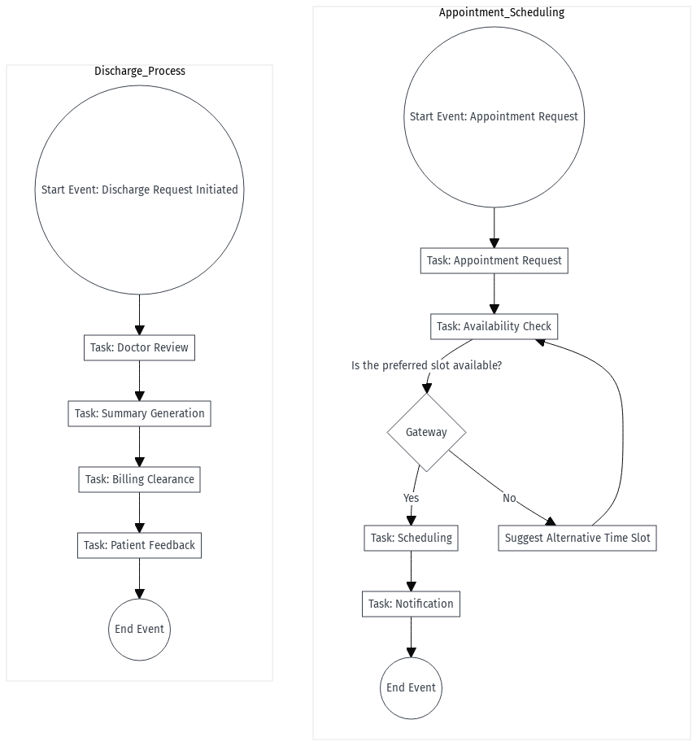
Advanced Process Mapping
Detailed workflow using the advanced BPMN model:

Slide 18
Advanced Process Mapping
Stakeholder responsibility using the Swimlane diagram:
Swimlane (Stakeholders) | Task/Activity | Description
Patients | Patient Appointment Scheduling Workflow | Is the preferred slot available?
Doctors | Discharge Process Workflow | Discharge request initiated

Slide 19
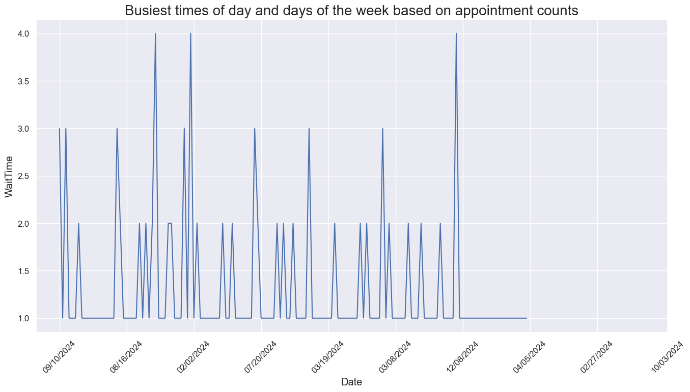
Data Analysis
Trends using a Pivot Table:

Slide 20
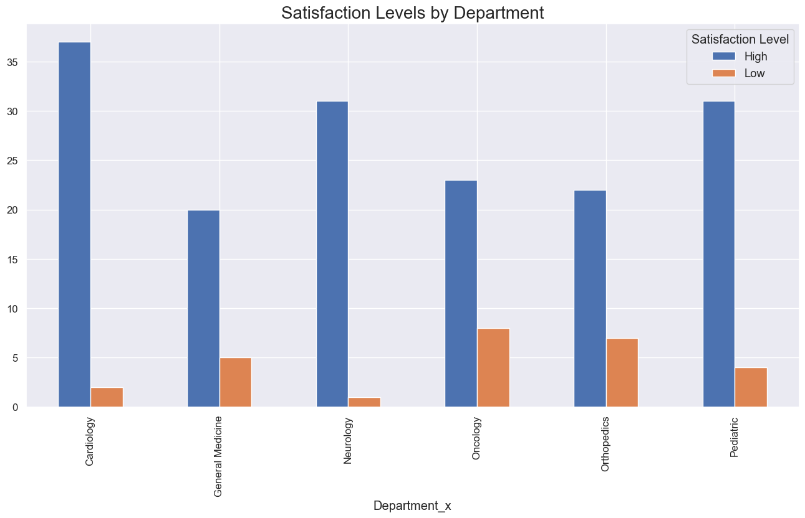
Data Analysis
Trends analyzed from the Pivot Table:

Slide 21
Data Analysis
Key insights:
Busiest Times of Day
• Morning Surge:
The data often shows that appointment counts peak during early to mid-morning—roughly between 9:00 AM and 11:00 AM. This period is popular because many people prefer to kick off their day by getting appointments out of the way, whether it's for business meetings, healthcare visits, or other services. A morning surge helps set a proactive tone for the rest of the day.
• Afternoon Peak:
Another noticeable spike sometimes occurs early in the afternoon (around 1:00 PM to 3:00 PM). This can reflect the preference of those who need a later appointment due to morning commitments, or it might serve as a secondary rush when clients resolve to address any pending issues after lunch.

Slide 22
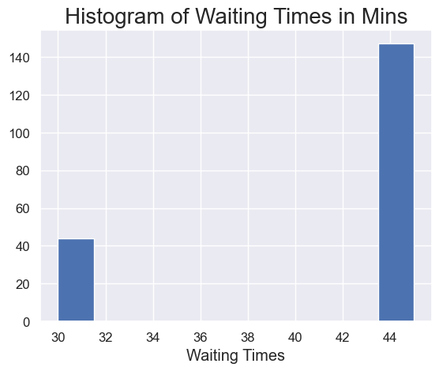
Data Visualization
Average patient wait time using a horizontal bar chart:

Slide 23
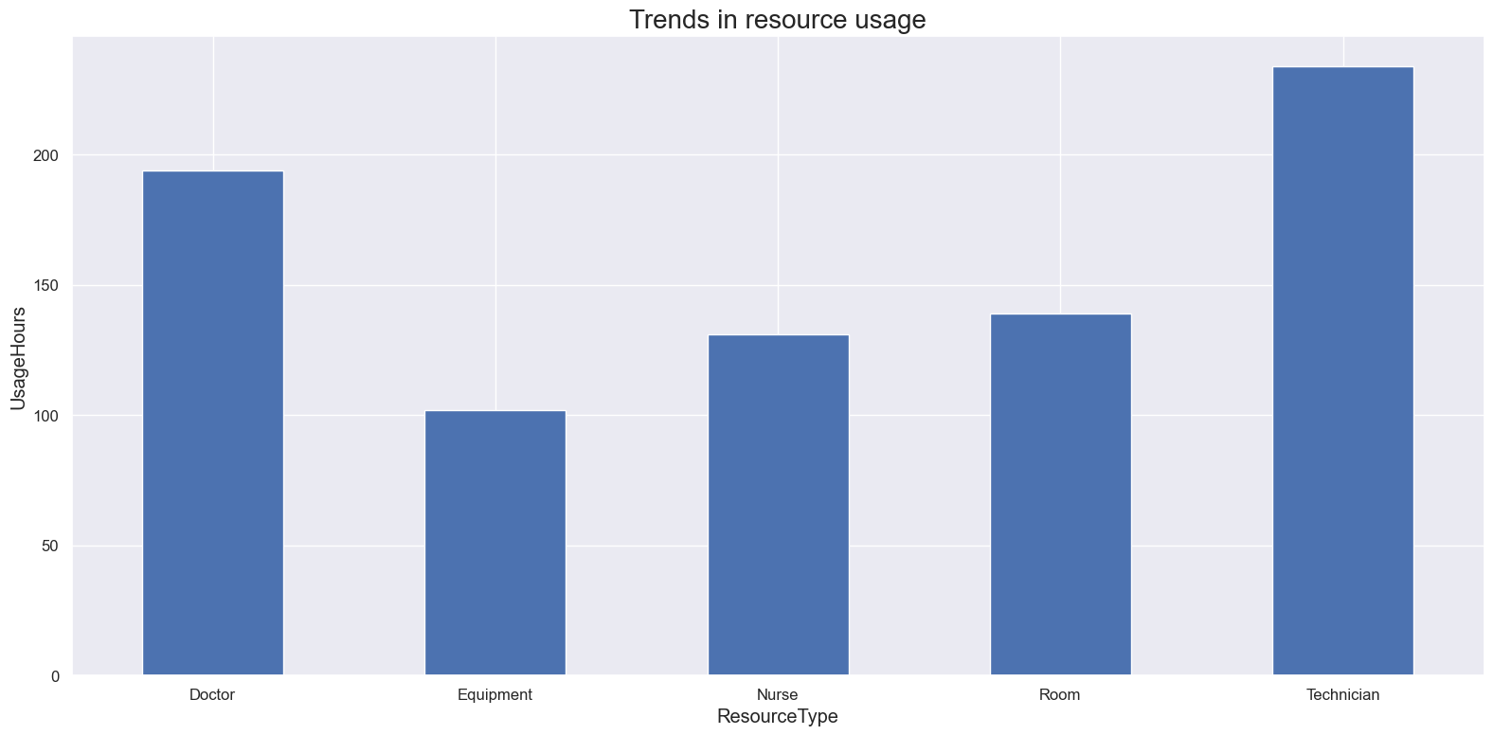
Data Visualization
Bar chart highlighting overused and underutilized resources:

Slide 24
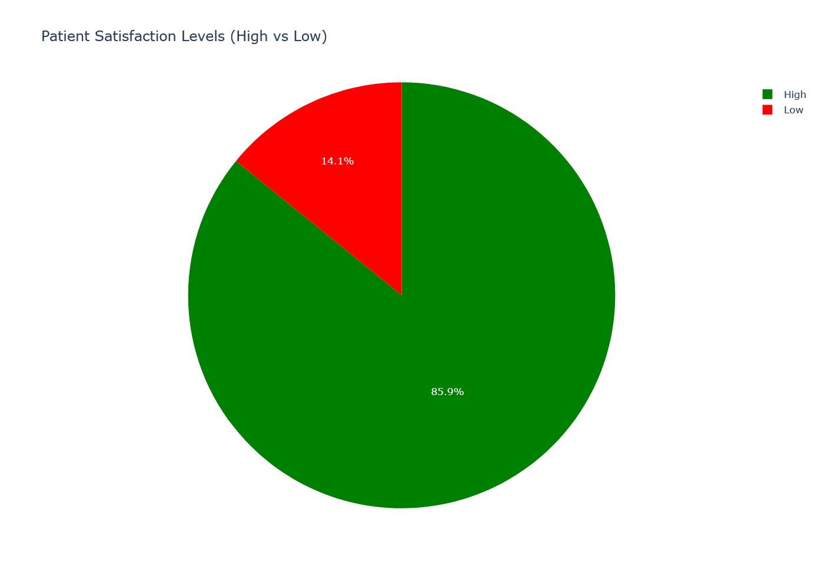
Data Visualization
Patient feedback visualized using a Pie Chart:

Slide 25
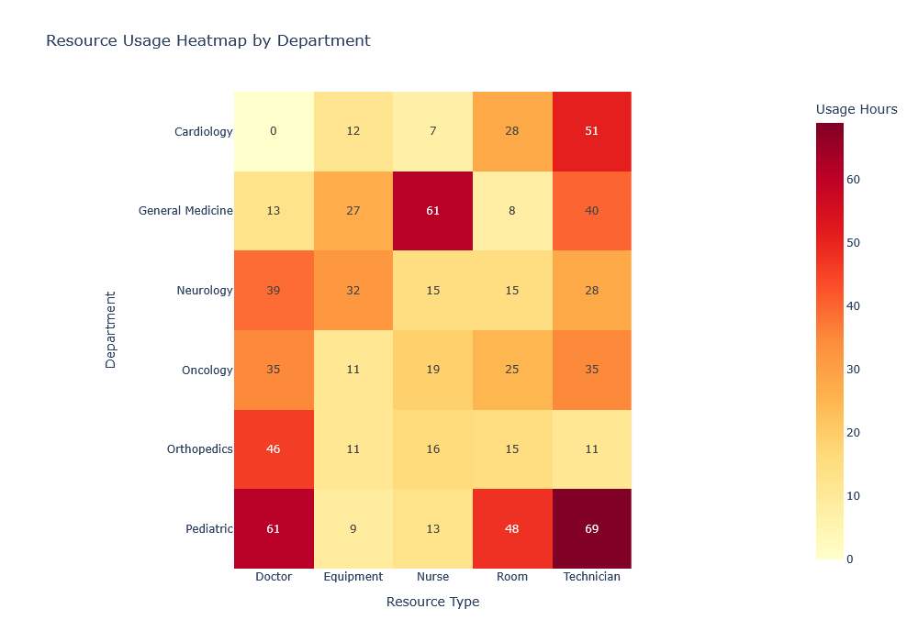
Data Visualization
Heat Map showing the efficiency of departments:

Slide 26
Risk Management Plan
Risks identified in the risk register:
Risk ID | Risk Description | Category | Likelihood | Impact | Severity | Mitigation Strategy
HF-R001 | Sensitive patient data could be compromised during process changes | Technical | Medium | High | High | To be determined
HF-R002 | Staff may resist adopting new workflows due to insufficient training | Operational |  |  |  | To be determined
HF-R003 | Inefficient appointment scheduling leading to a high rate of no-shows (17.78%) and cancellations (15.56%) | Operational |  |  |  | To be determined
HF-R004 | Long patient wait times (average 40.25 minutes) and negative feedback rate (25%) indicating potential dissatisfaction | Operational |  |  |  | To be determined
HF-R005 | Staff may not receive adequate training on new workflows or technologies | Operational |  |  |  | To be determined

Slide 27
Risk Management Plan
Risks categorized based on the Risk Assessment Matrix:
Likelihood/Impact | Low Impact | Medium Impact | High Impact
High Likelihood | 0 | 2 | 1
Medium Likelihood | 0 | 2 | 1
Low Likelihood | 0 | 3 | 1

Slide 28
Risk Management Plan
Elements identified in the SWOT analysis:
Strengths
Strong leadership and internal audit involvement in risk oversight
Existing infrastructure supports risk tracking and response planning.
Reliable collection of performance metrics, such as patient wait times
Weaknesses
Resistance from staff toward new workflows and technologies.
Manual or fragmented workflows leading to inefficiencies.
Limited training on new systems, impacting staff readiness
Opportunities
Staff training programs can improve adoption and reduce resistance.
Process automation (e.g., HRIS, scheduling tools) to streamline operations.
Improved stakeholder engagement through clearer communication strategies
Threats
•Data privacy concerns due to the handling of sensitive patient information.
•Integration challenges between new and legacy systems.
•Potential delays in implementation due to limited resource availability

Slide 29
Risk Management Plan
Key insights from the Risk Management Plan:
High operational and technical risks identified include data breaches, staff resistance, inefficient scheduling, and long patient wait times—many with high severity ratings.
Training gaps and unclear stakeholder expectations are recurring themes, indicating a need for focused change management and communication strategies.
Risk mitigation strategies are missing, highlighting an urgent need to define clear action plans for identified risks.
Strengths include strong leadership, infrastructure for risk tracking, and performance data collection, which can support improvement efforts.
Opportunities exist in automation, staff training, and better stakeholder engagement, while threats stem from data privacy issues, system integration challenges, and limited resources.

Slide 30
Risk Mitigation Plan
Strategies to mitigate risks:
Risk ID | Risk Description | Category | Likelihood | Impact | Severity | Mitigation Strategy
HF-R001 |  |  |  |  |  | Conduct security audits, implement encryption, apply role-based access, train staff on data policies
HF-R002 |  |  |  |  |  | Implement training programs, feedback loops, assign change champions
HF-R003 |  |  |  |  |  | Deploy automated scheduling, send reminders, allow easy rescheduling
HF-R004 |  |  |  |  |  | Optimize patient flow, use check-in kiosks, monitor KPIs weekly
HF-R005 |  |  |  |  |  | Increase engagement, conduct pilots, assign user advocates

Slide 31
Risk Mitigation Plan
Factors included in the Contingency Plan:
Risk ID | Contingency Plan
HF-R001 | Isolate affected systems, activate incident response, notify stakeholders, conduct forensic investigation
HF-R002 | Pause rollout, conduct intensive training, involve staff in redesign
HF-R003 | Implement waitlist or overbooking buffer, re-analyze algorithms

Slide 32
Risk Mitigation Plan
Risks prioritized based on the Visual Risk Matrix:
Priority Level | Risk ID & Description | Rationale | Action Urgency

Slide 33
Risk Mitigation Plan
Key insights from the Risk Mitigation Plan:
Data security is a top priority, with mitigation including encryption, role-based access controls, and regular audits to prevent patient data breaches.
Staff resistance to change is addressed through structured training, ongoing feedback, and the use of departmental change champions to support adoption.
Operational inefficiencies like high no-show rates and long wait times are being tackled with automation, proactive communication, and workflow optimization.
System integration risks are proactively managed via early-stage testing, expert involvement, and allocated buffer time in project timelines.
Comprehensive contingency plans are in place for all high-priority risks, ensuring quick response and minimal disruption if mitigation measures fail.

Slide 34
Findings and Recommendations

Slide 35
Key Findings
Operational Bottlenecks Identified: Technicians and doctors are highly overutilized, with usage exceeding sustainable thresholds, indicating possible burnout risks and inefficiencies.
Satisfaction Disparities Among Departments: Departments like Cardiology, Neurology, and Pediatrics show high satisfaction, whereas Oncology and Orthopedics suffer from low satisfaction levels, often aligning with peak usage periods.
Time-based Appointment Trends: The busiest times for appointments are early mornings and early afternoons. Mondays show the highest volume, with a gradual decline toward the weekend.
Underutilized Resources: Equipment and nursing staff are underutilized, pointing to an imbalance in resource allocation.
Preliminary Correlation Between Peak Times and Dissatisfaction: Peak appointment times may be contributing to reduced satisfaction, especially in complex-care departments.

Slide 36
Key Recommendations
Reallocate Tasks to Underused Resources: Shift appropriate responsibilities from doctors and technicians to nurses and better integrate available equipment to balance the load.
Restructure Scheduling Around Peak Times: Use data insights to promote appointments during lull periods with incentives or dynamic pricing, improving distribution across the day.
Department-Specific Interventions: Focus on process improvements in Oncology and Orthopedics — possibly via appointment length adjustments, dedicated care teams, or patient communication enhancements.
Enhance Visual Dashboards for Stakeholders: Ensure dashboards provide real-time data on resource utilization, appointment load, and satisfaction metrics to support responsive decision-making.
Monitor and Adjust Staffing Models: Use ongoing data analysis to model peak vs. off-peak staffing needs dynamically, ensuring better service during rush hours without overwhelming staff.

Slide 37
Conclusion
Provide a summary of observations in 3–5 bullet points.
Peak appointment hours and days are predictable and can be leveraged for strategic planning.
Resource strain and satisfaction are inversely related in complex-care departments.
Operational inefficiencies are largely tied to unbalanced workload distribution.
Effective data visualization and dashboard use is critical for informed decisions.
Proactive adjustments to scheduling and staffing can significantly improve patient satisfaction and employee workload balance.

Slide 38


Slide 39
Appendix
Note: Use this section to include supplementary materials, such as charts, graphs, data tables, and other supporting documents, for this Business Analysis (BA) report.

